Slide 1
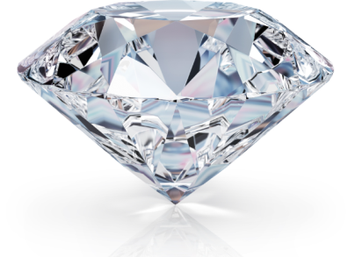







Diamond Jewels Sales & Data Analysis
By Yash Maurya

Slide 2
Introduction
The project focuses on analyzing diamond sales data to understand customer purchasing behavior.
The dataset includes key information such as transaction details, customer demographics, and product features.
Various aspects of the sales data are explored, including:-
A) Age, gender, and Product category.
B) Product categories and diamond characteristics (e.g., carat, clarity, color).
C) Sales trends across different states and cities.
The analysis aims to uncover insights into popular product categories, high-spending customer segments, and geographical sales patterns.
Predictive modeling is applied to forecast future customer behavior and optimize business strategies.
This project provides valuable insights to improve marketing, sales, and inventory management.

Slide 3



Aim
The primary aim of this project is to analyze diamond sales data to uncover key insights related to customer purchasing behavior, popular product categories, and geographic sales trends. Using exploratory data analysis (EDA) and predictive modeling, this project seeks to:
Identify the age groups and genders driving the highest diamond sales.
Determine which product categories are most popular across various states and cities.
Provide actionable insights into pricing, discount effects, and payment methods.
Build a machine learning model to predict customer purchase patterns based on demographic and sales features.

Slide 4
Dataset Overview
Dataset Size:-
Contains 10,000 ‘Rows’ and 14 ‘columns’.
Key Features:-
Transaction_ID: Unique identifier for each diamond sale.
Date_of_Sale: Date when the transaction took place.
Customer_Age: Age of the customer making the purchase.
Customer_Gender: Gender of the customer (Male/Female).
State & City: Location where the purchase was made.
Product_Category: Category of diamond products (e.g., Ring, Necklace, Earring).
Carat: Weight of the diamond in the product.
Diamond_Clarity: Clarity grade of the diamond (e.g., VVS1, SI2).
Diamond_Color: Color grade of the diamond (e.g., F, G).
Price: The sale price of the diamond product.
Payment_Method: Mode of payment used (e.g., Cash, Credit Card).
Discount_Applied: Discount percentage applied to the product.

Slide 5

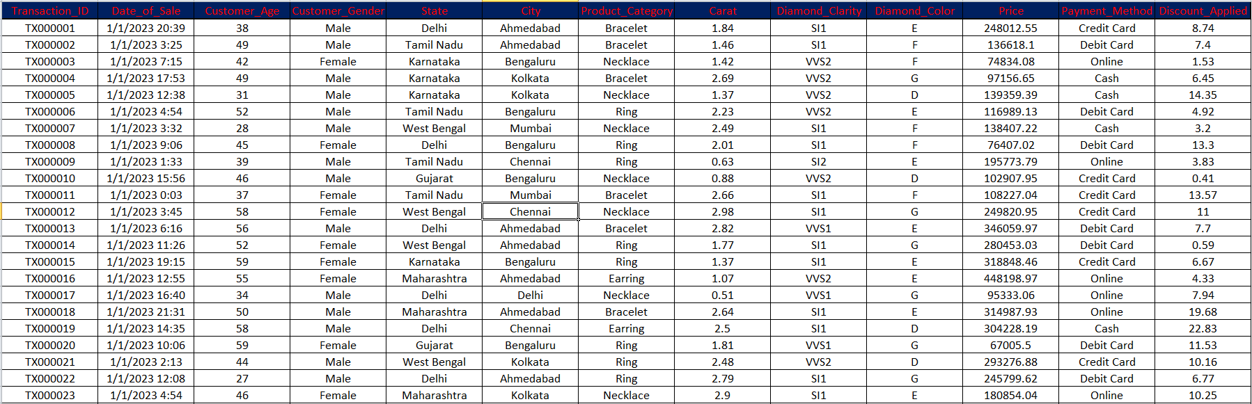
Data Set Preview All The Key Features

Slide 6
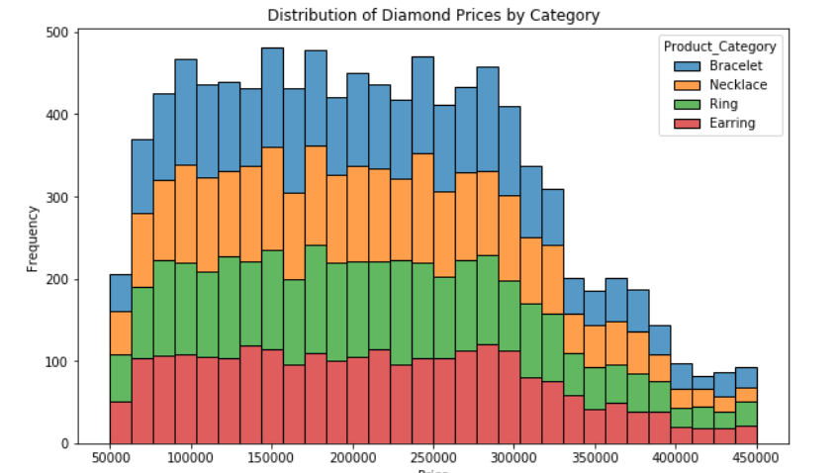
Diamond Price By Jewellerys Category
1). The bar graph shows how diamond prices are spread out.
3). There aren't many diamonds that cost over 400,000 units.
4). This means there are a lot of mid-priced diamonds available.
5). This could affect what customers like and what's popular in the market.
2). Most of the prices are between 100,000 and 300,000 units.

Slide 7
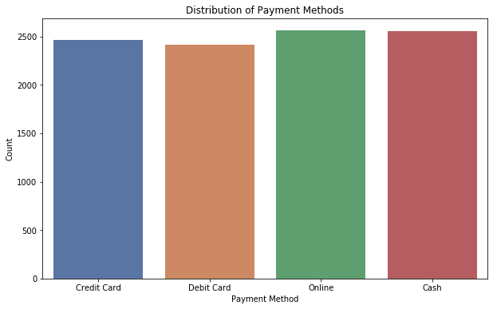
Different Payment Method
The graph shows that there are four payment methods for the product. It is evident that there is a difference in payment methods. Most of the time, customers use the "online" payment method, followed by "cash," "credit card," and finally "debit card."

Slide 8
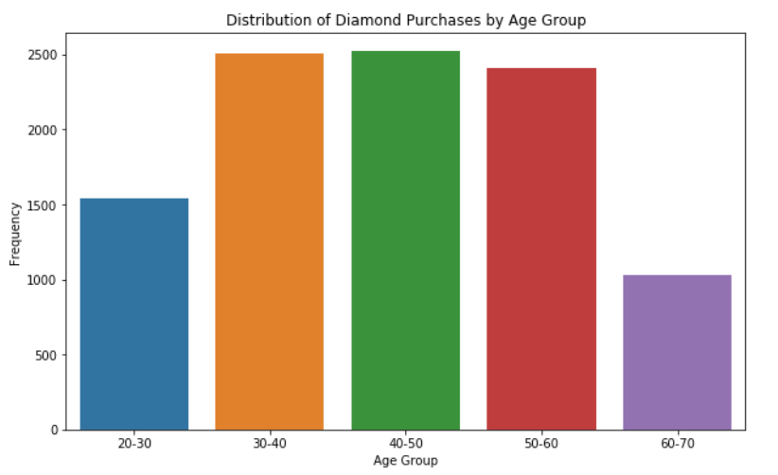
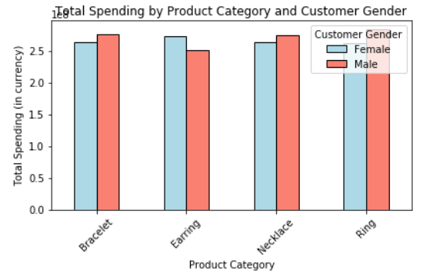
Customer Demographics
The graph illustrates that total spending varies between males and females based on the product category. It reveals that females tend to prefer earrings and necklaces, while males lean towards bracelets and rings. This suggests that spending behavior is influenced by the type of product.
The data shows that people from various age groups are buying diamond jewelry. The majority of buyers fall within the age range of 30-40 to 50-60. However, we need to determine which age group purchases the most jewelry.

Slide 9
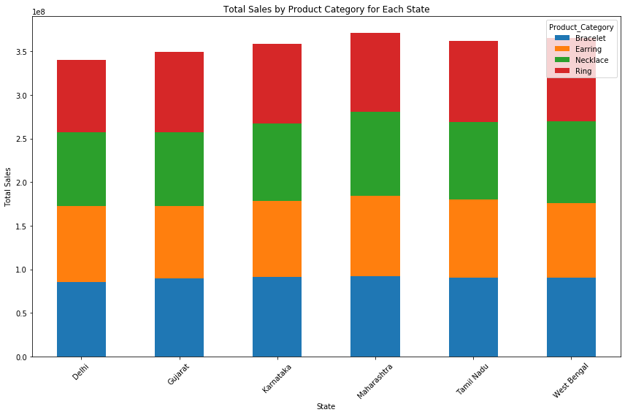
The bar graph titled “Total Sales by Product Category for Each State” compares sales across five states:Delhi, Gujarat, Karnataka, Maharashtra, Tamil Nadu, West Bengal. Each state has bars representing different product categories: Bracelets, Earrings, Necklaces,and Ring. Maharashtra leads in total sales for most categories, while West Bengal excels in Pendants and Rings. This visual helps identify which product categories perform best in each state, providing valuable insights for strategic sales planning.
Sales Of Product By States
Bracelet
Earring
Nacklace
Ring
Product category

Slide 10
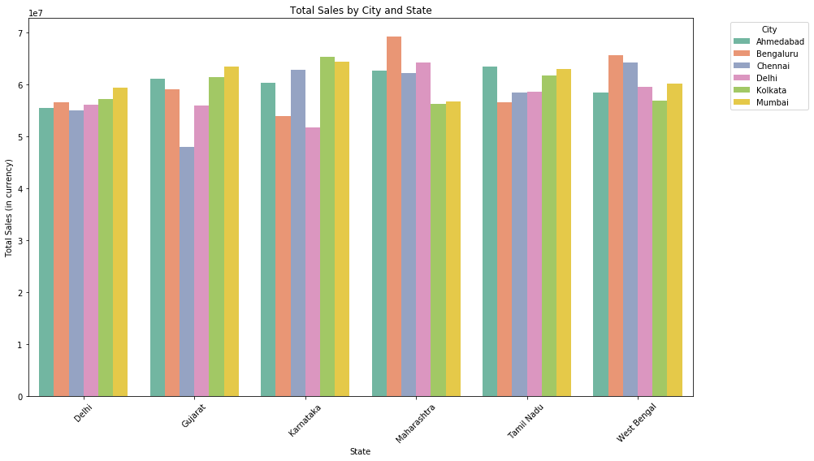
Total Sales of city and sates

Slide 11
Total Sales of city and sates
Sales Distribution:-
Graph shows total diamond product sales across cities in various states.
Cities Represented:-
Includes Ahmedabad, Bengaluru, Chennai, Delhi, Kolkata, and Mumbai.
Key Insights:-
Fluctuations in sales highlight varying consumer preferences.
Heights of bars indicate sales performance across cities.
Strategic Implications:-
Identifies high-performing cities for targeted marketing.
Suggests need for further analysis into factors influencing sales.
Conclusion:-
Visualization aids in understanding market dynamics and planning sales strategies.

Slide 12
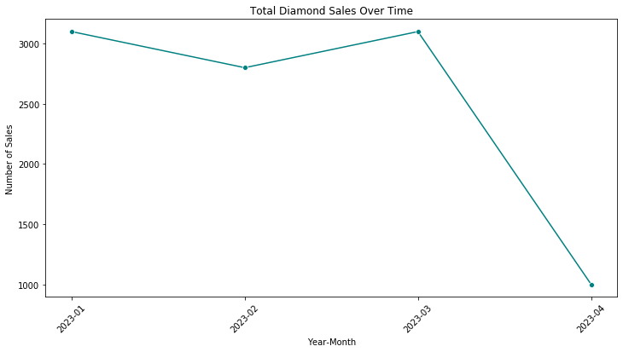
Total Sales Over Time Of Diamond
The graph titled "Total Diamond Sales Over Time" shows a significant decline in diamond sales from January 2021 to April 2021. Here are the key points:
Initial High Sales: In January 2021, sales were near 3500.
Gradual Decline: Sales slightly decreased in February 2021.
Sharp Drop: By April 2021, sales had drastically fallen to just above 1000.
This trend indicates a notable decrease in diamond sales over the four-month period.

Slide 13
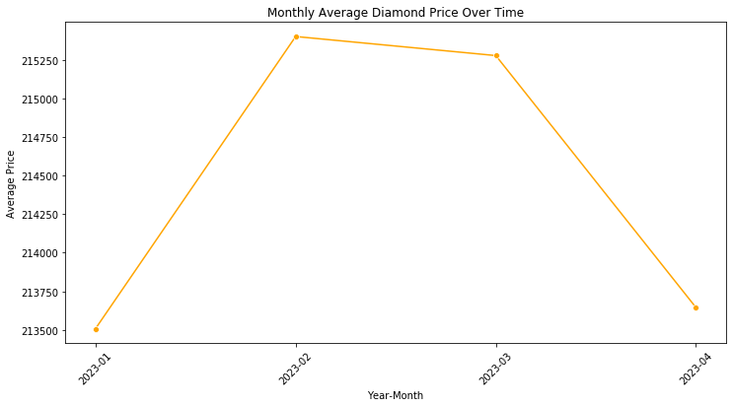
Monthly Diamond Price Over Time
The graph shows the changes in the average price of diamonds from January 2023 to April 2023.
There was a notable decrease in the average price of diamonds from January 2023 to February 2023. Subsequently, the price sharply increased from February 2023 to March 2023. Finally, there was a slight decline in price from March 2023 to April 2023.

Slide 14
Insights And Trends After (EDA)
Customer Demographics:-
Age Group Insights:Customers aged between 30-40 years made the most purchases across all product categories.Females in the age range of 35-45 years showed a higher propensity for buying luxury items like necklaces and bracelets.
Gender Trends:- Males tended to buy more rings, while females preferred earrings and necklaces.
Regional Sales:- State-wise Trends:Maharashtra and Gujarat recorded the highest sales overall, contributing significantly to total revenue.
City-wise Insights:- Mumbai and Ahmedabad emerged as top cities for diamond purchases.
Product Popularity:- Rings were the most popular product category, making up a significant portion of the sales.Bracelets saw higher average prices compared to other products, often bought by customers aged 40+.
Pricing and Discounts:- Higher discounts correlated with increased sales, especially for earrings and necklaces.The average price of products in Gujarat was higher compared to other states, likely due to demand for premium products.
Payment Methods:- Credit Card and Online Payment methods were the most used by younger customers (aged 20-35).Cash payments were more frequent among older customers (aged 50+).

Slide 15
Model Building
Feature Selection: Identified key features such as carat, customer age, diamond clarity, and product category that influence diamond prices.
Data Preprocessing: Applied one-hot encoding to convert categorical variables into numerical format for better model compatibility.
Train-Test Split: Divided the dataset into training (80%) and testing (20%) sets to evaluate model performance.
Model Selection: Built multiple regression models including:
Random Forest
Linear Regression
Decision Tree
Gradient Boosting
Model Training: Trained each model on the training dataset to learn patterns.
Evaluation: Assessed model performance using Mean Squared Error (MSE) and R² score, selecting the best-performing model for predictions.

Slide 16
Model Result After building
RandomForest - Mean Squared Error: 10258708733.29
LinearRegression - Mean Squared Error: 9389628334.08
DecisionTree - Mean Squared Error: 19508634941.82
GradientBoosting - Mean Squared Error: 9486948908.67
Model Performance Comparison:-
RandomForest: 10258708733.29
LinearRegression: 9389628334.08
DecisionTree: 19508634941.82
GradientBoosting: 9486948908.67

Slide 17
Model Building After Result Explanation
Based on the results of the four models, here's a conclusion:-
Linear Regression performed the best, with the lowest Mean Squared Error (MSE) of 9.39 billion. This suggests that the relationship between the features and the target variable (price) can be well-approximated by a linear model.
Gradient Boosting Regressor also performed quite well, with an MSE of 9.49 billion, showing it can handle more complex relationships slightly better than RandomForest.
Random Forest Regressor had a moderately higher MSE of 10.26 billion, indicating that while it captures some non-linearities, it may not generalize as well as Gradient Boosting or Linear Regression in this case.
Decision Tree Regressor had the highest MSE at 19.51 billion, indicating that it overfits the data and performs poorly compared to the other models.
In conclusion, Linear Regression and Gradient Boosting are the most suitable models for predicting diamond prices based on the given features, with Linear Regression slightly outperforming other models. However, Gradient Boosting offers a good balance for capturing complex patterns while avoiding overfitting.

Slide 18
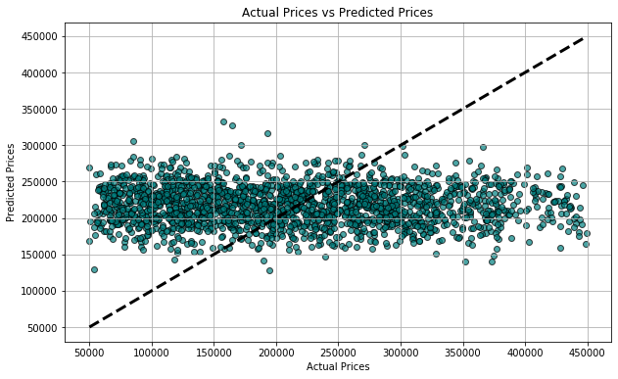
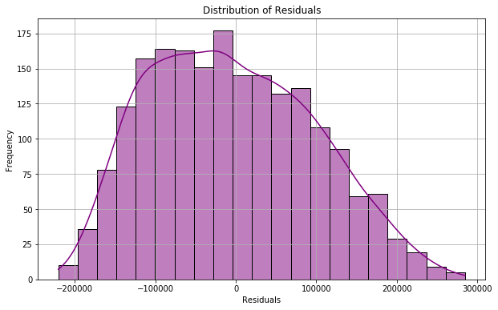
Visualization of Results
The scatter plot indicates that there is a strong relationship between actual and predicted prices, showing that the model used for prediction is generally accurate. However, there are some outliers, which means that while many predictions are close to the actual values, there are instances where the model’s predictions are less accurate. This suggests that the model is good at making predictions but still has room for improvement to handle anomalies and improve overall accuracy

Slide 19
Conclusion
This project successfully analyzed diamond sales data to uncover valuable insights into customer behavior and market trends. By examining factors such as age, gender, and geographic location, we identified key purchasing patterns that can inform targeted marketing strategies. The predictive modeling further enhances our understanding of future sales potential, enabling data-driven decision-making.

